Slide 1

BUSINESS PLAN
BUDDAKAN RESTAURANT
LONDON
03 APRIL 2020

Slide 2
CONTENTS
1
2
3
4
INTRODUCTION
DATA
METHODOLOGY
CONCLUSION
Business problem and Target Customers interested in this project.
Data used to solve the problem and the source of the data.
Exploratory data analysis and Machine Learning algorithm used.
Conclusion of the report.

Slide 3

PART 01
INTRODUCTION
Buddakan is a restaurant chain serving New American Asian cuisine owned by STARR Restaurants. Buddakan presents the vivid flavors of the Far East in a surreal atmosphere that marries the serenity of Asia with the flamboyance of 16th-century Paris.

Slide 4

About
Objective of the Restaurant
Buddakan is planning to open a restaurant in the heart of United Kingdom, London, to broaden their Asian fusion food venture into the United Kingdom.
A Geo spatial data analysis of the city of London is to be performed to determine the best location to open the restaurant. Since Buddakan is an Asian Fusion style restaurant, The target audience is mostly Asian and White.

Slide 5

PART 02
DATA
The data for determining the best Neighborhood(s) with most target audience is provided by London Data store. The London Data store is an open source platform to access London’s data for free. The London Data store is created by the Greater London Authority (GLA).

Slide 6
LOCATION DATA
The data consisting of the location of each borough in London along with the co-ordinates is scraped from the web through a Wikipedia page: https://en.wikipedia.org/wiki/List_of_London_boroughs
This data is merged with the population data to determine the latitude and longitude of each borough.
POPULATION DATA
The Data set containing the population of each borough classified based on ethnicity is used to perform the analysis. The data set consists of all 33 boroughs in London along with the respective population for each Borough.
NEIGHBORHOOD DATA
The data consisting of the neighborhoods of each borough in London is scraped from the web through the Wikipedia page: https://en.wikipedia.org/wiki/List_of_areas_of_London
This data is merged with the merged population data and location data to determine the best neighborhood(s) to pen the restaurant.

Slide 7

PART 03
METHODOLOGY
The population data is taken into a data frame and is merged with the location data. Data is cleaned, processed and sorted in such a way that the final data frame consists of both the population and location of each borough in London.

Slide 8
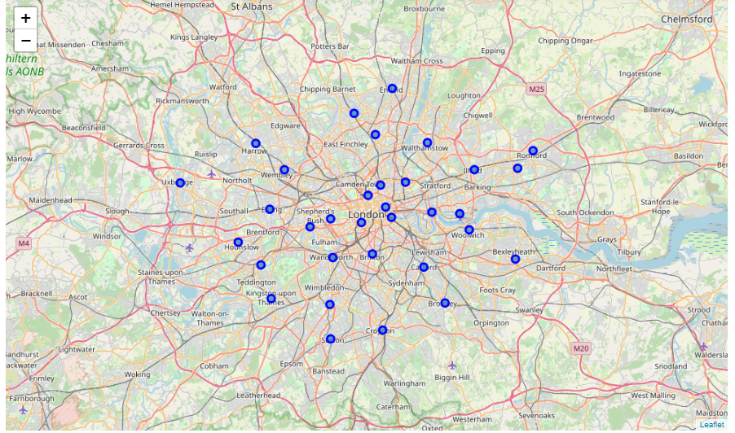
DATA ANALYSIS
PREPARATION & VISUALIZATION
The population data is taken into a data frame and is merged with the location data. Data is cleaned, processed and sorted in such a way that the final data frame consists of both the population and location of each borough in London
A map showing all the boroughs in London is created using the folium library.
The geographical co-ordinates of London is retrieved using geocoders from the geopy library and the map showing all the boroughs in London is created.
The Boroughs are marked by markers.

Slide 9
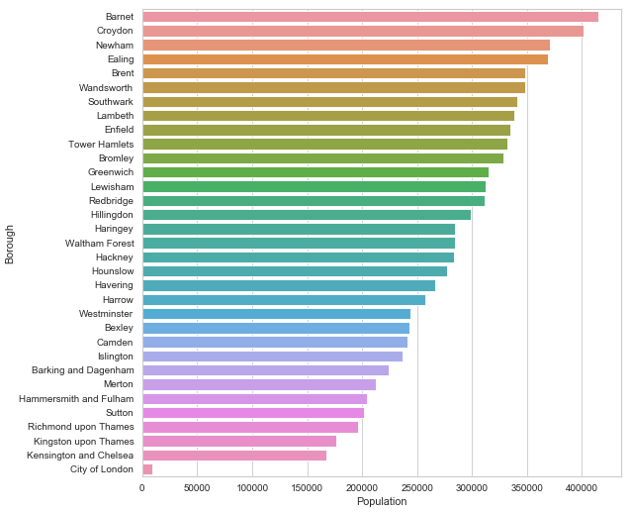
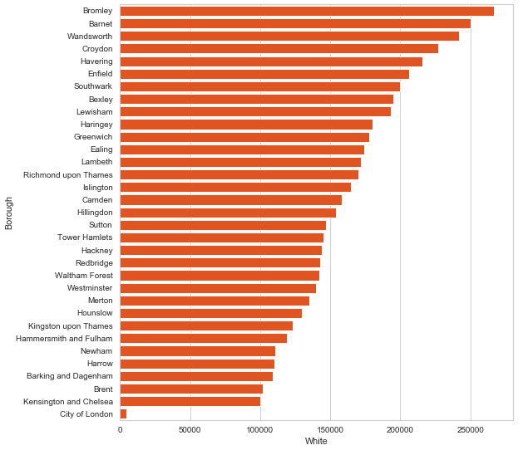
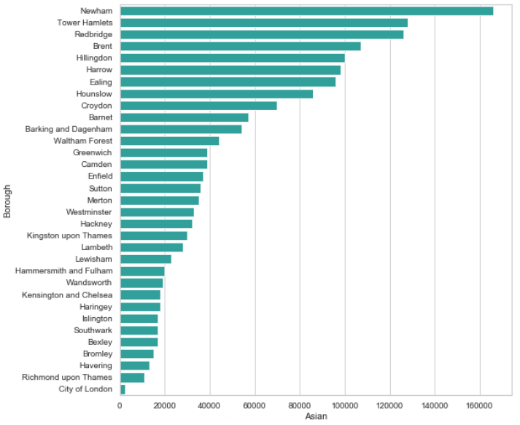
EXPLORATORY DATA ANALYTICS
BOROUGH VS ETHNICITY
Borough vs Population
Borough vs White
Borough vs Asians

Slide 10
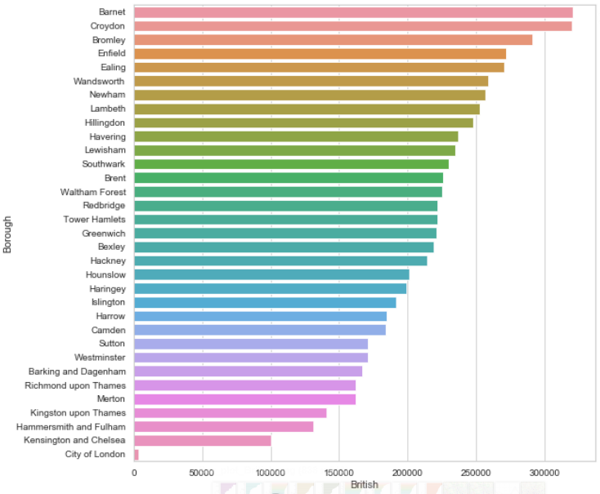
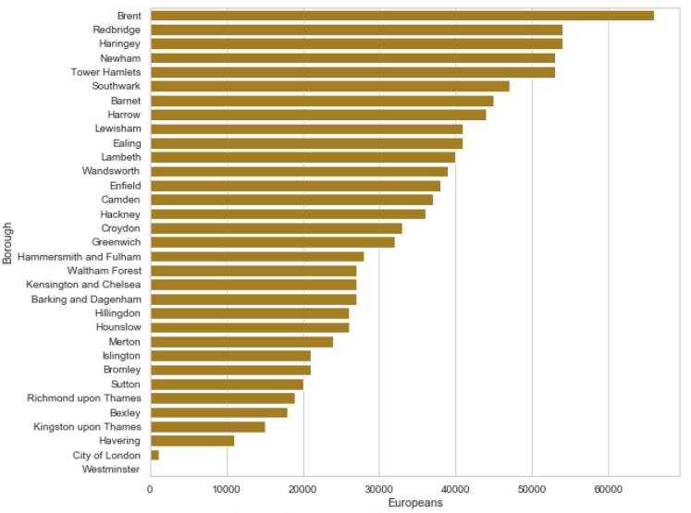
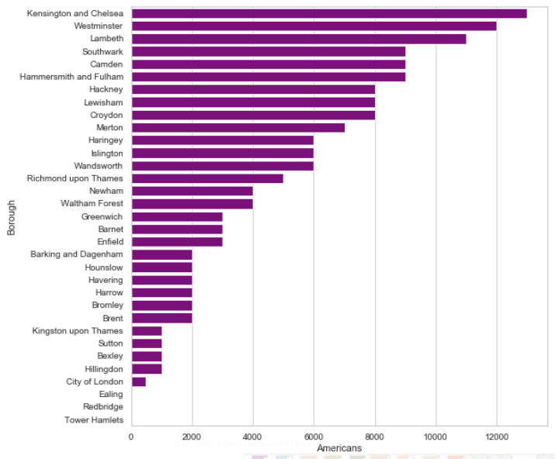
EXPLORATORY DATA ANALYTICS
BOROUGH VS NATIONALITY
Borough vs British
Borough vs Europeans
Borough vs Americans

Slide 11
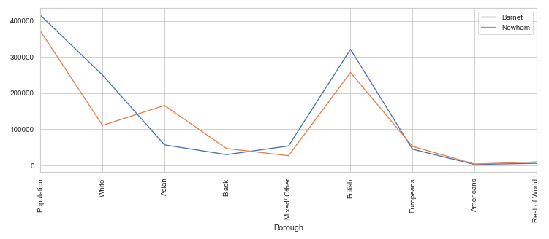
EXPLORATORY DATA ANALYTICS
BARNET VS NEWHAM
Barnet vs Newham

Slide 12

BOROUGH VS ETHNICITY
EDA of Borough vs Ethnicity was performed.
RESULTS
BARNET VS NEWHAM
BOROUGH VS NATIONALITY
EDA of Borough vs Nationality was performed.
Based on the EDA performed on ethnicity and nationality, We can narrow down the list of boroughs from 33 to 2 boroughs: Barnet and Newham. These two boroughs are chosen for final EDA. Performing further EDA using line graph on Barnet vs Newham, We can conclude that Barnet is the best suited borough to open the restaurant based on Total population, White population, Asian population, Mixed / Other population, British population, European population, American population and Rest of the world population.
BARNET VS NEWHAM
EDA of Barnet vs Newham was performed.
NEIGHBORHOODS OF BARNET
EDA of Neighborhoods of Barnet was performed.

Slide 13
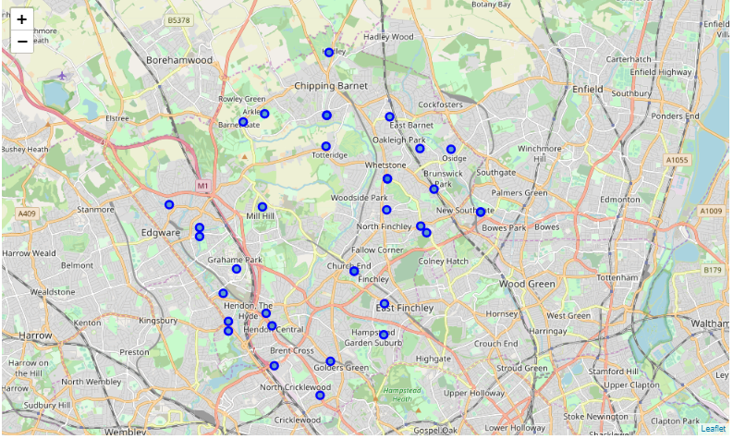
BARNET BOROUGH
NEIGHBORHOODS OF BARNET BOROUGH
The data consisting of the neighborhoods of each borough in London is scraped from the web through the Wikipedia page: https://en.wikipedia.org/wiki/List_of_areas_of_London
A map showing all Barnet borough and all it's neighborhoods in London.
This data is merged with the merged population data and location data to determine the best neighborhood(s) to open the restaurant.
The Neighborhoods are marked by markers.

Slide 14
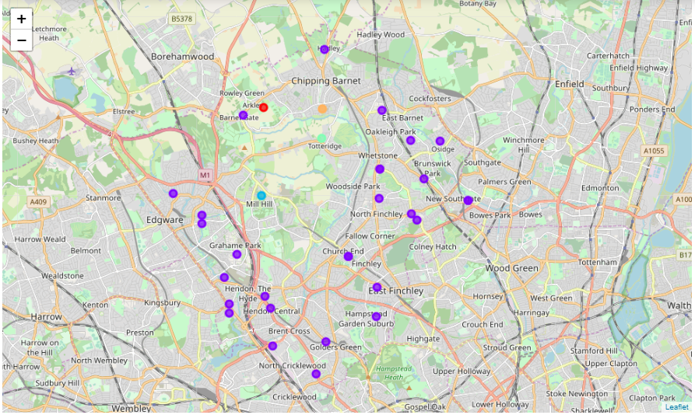
CLUSTERING
NEIGHBORHOODS OF BARNET BOROUGH
All Neighborhoods under Barnet borough is segmented and clustered to analyze the 10 most visited places. One hot encoding method is applied to the data set and 10 most visited places for each neighborhood is determined through K-means clustering algorithm.
A map showing all clusters of neighborhoods in Barnet borough, London.
The neighborhoods are clustered into 5 clusters based on location and each cluster is marked in the borough map
The clusters are marked by markers.

Slide 15

PART 04
CONCLUSION
Based on the analysis performed on various Boroughs and their Neighborhoods in London, We can recommend that Mill Hill, Hampstead Garden Suburb, Friern Barnet, Finchley, Colindale and The Burroughs are the best Neighborhoods in Barnet Borough to open the restaurant.

Slide 16
RECOMMENDED NEIGHBORHOODS
MILL HILL
FINCHLEY
HAMPSTEAD GARDEN SUBURB
COLINDALE
FRIERN BARNET
THE BORROUGHS

Slide 17
THANK YOU

